Slide 1

Threat Hunting for Lateral Movement
Corgi Edition
Presented by: Adam Fuchs – CTO
Co-conspirator: Ryan Nolette – Security Technologist and CCO

Slide 2

Agenda
Lateral Movement Overview
Structuring the Analysis
Detecting LMs with DataScience™
Threat Hunting around Detected LMs

Slide 3




What Is Lateral Movement?
Successful Data access from compromised host after lateral movement
Successful Lateral Movement
Patient 0: original Infection
Failed Data access from Patient 0
Company’s Customer Financial Records
Successful Lateral Movement
Failed Data access from compromised host after lateral movement
Notes:
To demonstrate a typical scenario, we’ll look at an example where the attacker will attempt to move from the patient 0 compromised system to gather the company's financial records. Next, the attacker discovers that they cannot directly access the files from the infected host. They then attempt to move laterally to another system they can see on the network. When this system also does not have access to the data the attacker wants, the attacker will attempt to move laterally again and again until finally finding a system with the access they want.

Slide 4

Infection to Lateral Movement Process
Rinse and Repeat for each system as needed or wanted
Infection Techniques
Phishing email
Drive by
Exploit kit
Flash drive
Stages
Infected system checks in with command and control server/s
Human Attacker gives command to infected system to allow access
remote shell
GUI interface options
Human attacker starts reconnaissance
Human Attacker interaction
Examples of recon:
netstat – see active network connections
Nmap – network scanner
Net use – access to resources
Net user – manage local/domain accounts
Task list – what processes are running on system
Tools
Mimikatz
Pwdump
Generic memory dump
Goal
To gather plaintext credential
Password hashes
Elevate your privileges
Login to new system
psexec - shell
RDP – GUI
Profit
Infection
Compromise
Reconnaissance
Credential Theft
Lateral Movement
Notes:
We can take the previous scenario and dissect it into stages.
First, we had the initial infection, this occurred by any ordinary means, phishing email, exploit kit, whatever.
Next, we have the compromise stage. This phase differs from the infection stage because we are defining compromise as the attacker has direct access to the system where the infection is defined as automated malware infecting the system. To expand on that, infection is something like getting a trojan on your computer, but compromise does not occur until the malware opens up a connection on the system for an attacker to get direct CLI access to the system.
The third stage is reconnaissance which contains the attacker collecting data about the system they are on and what other systems the attacker can see from the compromised host.
The next stage is credential theft. This stage is vital for the attacker because, without credentials, their ability to move laterally will be extremely limited. Credential theft comes in many forms, and we will dig into that in a bit.
Lastly, comes the actual lateral movement stage where the attacker combines the information they have gathered with the credentials they have gathered and attempt to authenticate to other systems in the environment. These three stages of recon, credential theft, and lateral movement, will be repeated on every system the attacker successfully authenticates.

Slide 5
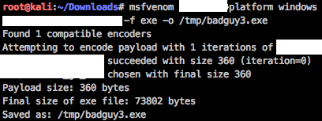
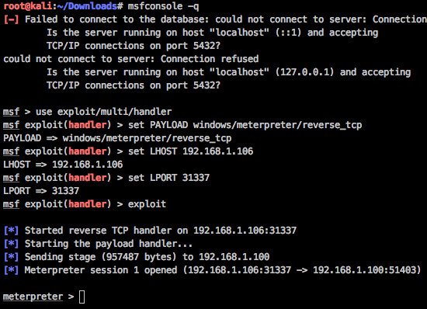
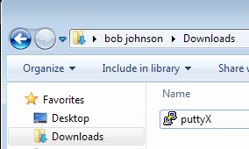
Infection– Back-doored executable
Compromise – Meterpreter Session
Creating the Malicious Payload
Infected Binary
Notes:
Now that we have a rough idea of the progression of this attack lifecycle let's dig into the stages a bit more.
First I am going to craft the malicious version of a legitimate binary. Here I am using a legitimate copy of putty and injection a malicious reverse_tcp payload.
I have also renamed the file from badguy3.exe to puttyX.exe so that the end user is not aware of the change in the file. Since I am skipping the infection stage in this write up, I will not be going into how I made this binary or how I tricked the user into running it. #PleaseDontSueMe
Communication with the compromised systems and C&C (command and control) servers is established
Threat actors need to sustain persistent access across the network
They move laterally within the network and gain higher privileges through the use of different tools
The first stage that matters is the compromise stage. What you see here is a popular penetration testing suite, called Kali, that is being used to connect to the reverse shell generated by the malware on the target host. You can see that with this shell, I as the attacker, have the ability to run admin-level commands to perform recon of the system and network it is on.
Communication with the compromised systems and C&C (command and control) servers is established
Threat actors need to sustain persistent access across the network
They move laterally within the network and gain higher privileges through the use of different tools
After sending the user the malicious binary I start a metasploit console that is going to wait and listen for a connection request from the user. Below you can see the session being started and initiated by the victim system.
You can also see that the last line in the image reads “meterpreter”. This means I now have a direct shell on the victim system from my attacker system. From this shell I can either run plugins, scripts, payloads, or start a local shell session against the victim.

Slide 6
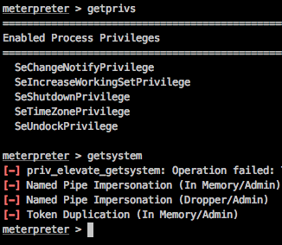
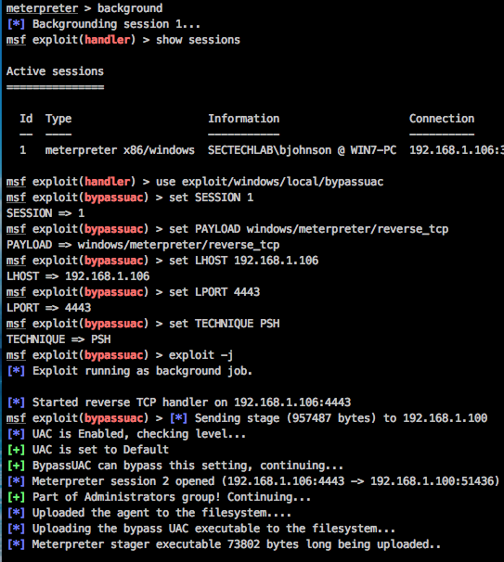
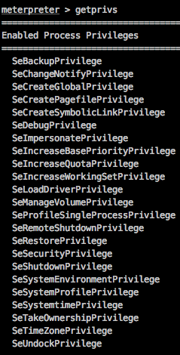
Compromise – discovering privileges
Compromise – elevate privileges
Compromise – confirm new privileges
Notes:
First thing I am going to do with my session is see what privileges I have.
Now that I have the session in the background, I am going to load up a generic UAC bypass exploit (this is patched in current windows versions) and run it against the victim system.
Well what do you know? This enterprise isn’t keeping up to date with their patches. Thanks to the successful UAC bypass, I know have a second session started on the victim and this session I can start my evil. How can I do this when the sessions look identical? I can do this because I just bypassed windows user access control. To prove i now have more access, I will rerun the getprivs command on the second session to see if I know have admin privs.
Discovering privileges of user who executed the infected binary and compromised the system
Here I can see that the user I have tricked into running my malware is not a local admin and i have very restricted privileges on the system. Good for SecOps but bad for me as an attacker. Luckily, I am not so easily blocked.
I am going to background my meterpreter session so i can load more attacks to use against the host. In this image we can see that the user I am running as is “bjohnson” in the domain “sectechlab” on the host “win7-pc”. I can also see that I am currently running as x86 windows and my victim IP is 192.168.1.100.
Bam! Money privs.
Now that I have admin privs, i can just simply give myself system level access and then start hiding myself by starting a new x64 process and migrating into that new process. Here I am choosing to use notepad but in reality this will popup and application on the victim system that the user can then quit and I will lose my session. What i really would do is run a process without a Graphical User Interface (gui) but I don't think I should show that here. #PleaseDontSueMe
Now that I have system level access and have hidden myself in a new process. Let’s start the recon!

Slide 7
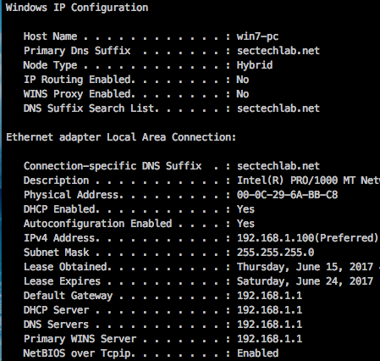
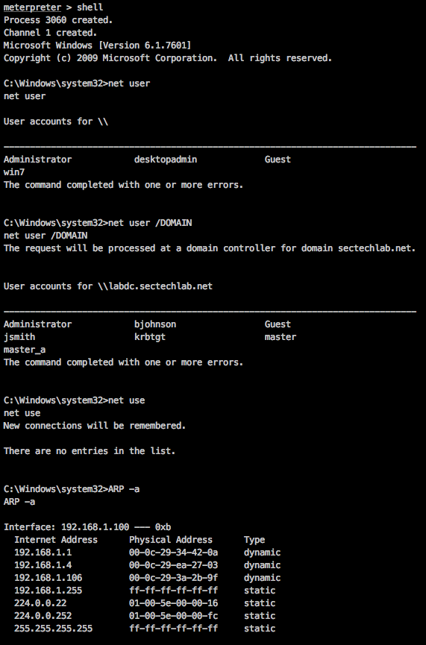
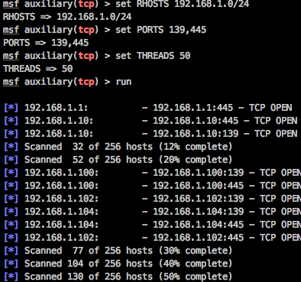
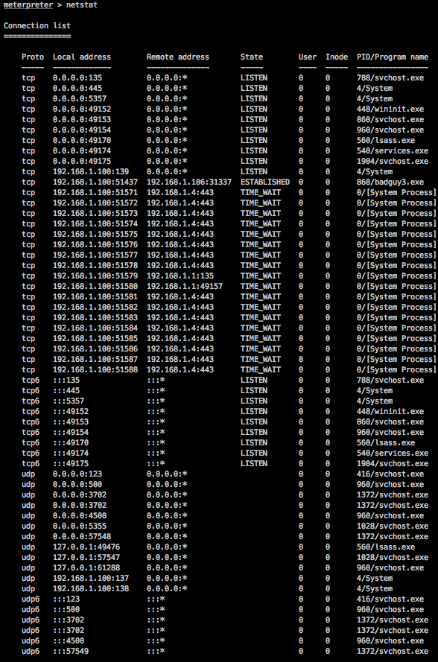
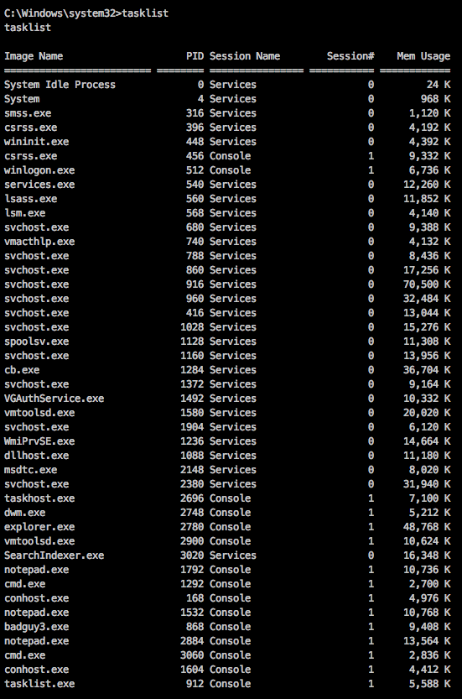
Recon – Network
Recon – User accounts
Recon Local Accounts
Nmap
Recon Domain Accounts
Check ARP table
Recon – Processes
Processes with Network Connections
Running Processes
Mounted Drives
Notes:
Now that we have direct CLI access to the compromised host, we need to enumerate the users on that host, the network that it is on, as well as gather generic system information like running processes and such for possible usage for persistence.
Waste not, want not.
The images that you see are of me using the net user command to find local users on the host as well as domain users who have previously logged in. What I am looking for are admin and power user level users that I can reuse elsewhere in the environment. The first thing I am looking for is the local admin accounts on the system. This account is commonly used as an IT backdoor to get into systems that are having AD issues and is commonly the same username and password on all systems in the environment because it is part of the build process. I beg you not to do this in your environments. There is even a GPO setting that randomizes the local admin password on your systems. There is no excuse for this anymore.
First I want see who I am and where I am. I will run some basic sysinfo, whoami, and hostname commands. But what I really want to know is who has been on this system and where this system is in the network.
To move laterally within a breached network and maintain persistence, attackers obtain information like network hierarchy, services used in the servers and operating systems
Check the host naming conventions to easily identify specific assets to target
Utilize this info to map the network and acquire intelligence about their next move

Slide 8
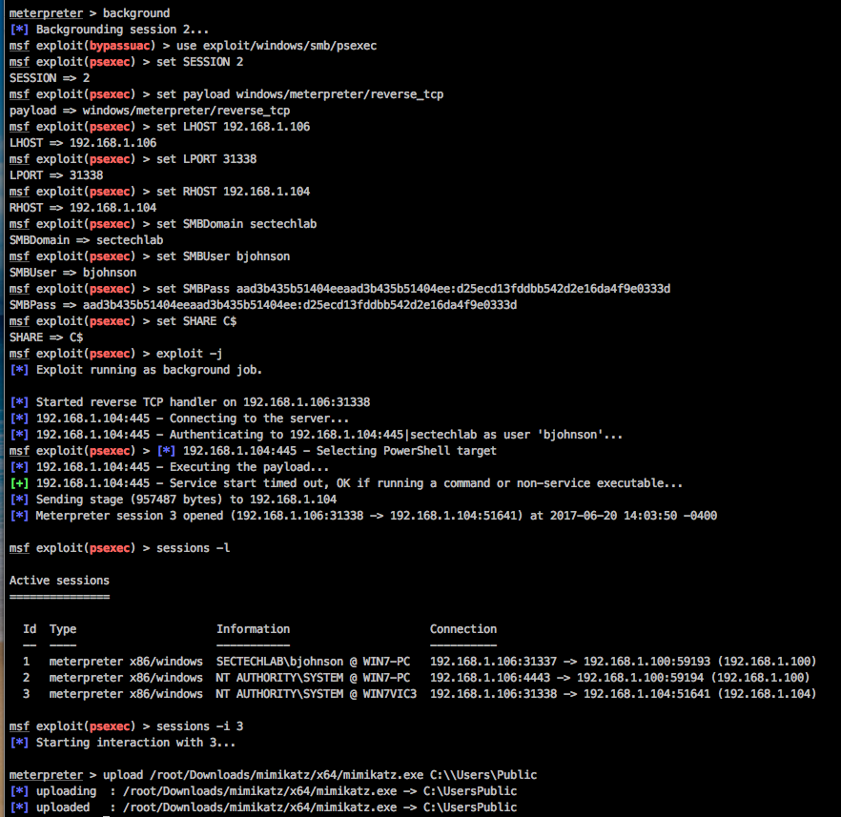
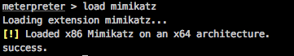
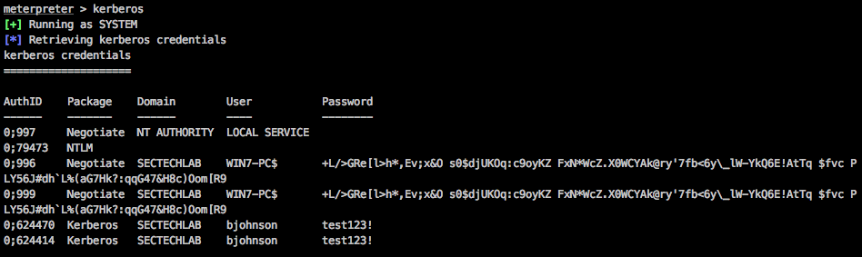
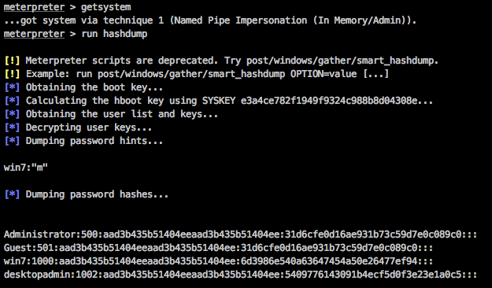
Credential Theft
Lateral Movement – Using Stolen Credentials
Running Mimikatz
Recover the Kerberos Hashes
Recover SAM hashes
Notes:
Next up we have the credential theft stage. What you see here is me running a mimikatz metasploit module. I used this because mimikatz will take credentials out of memory and crack the hashes for me. This allows me to harvest credentials without having to put an executable on the system. These activities are often unnoticed by IT administrators, since they only check failed logins without tracking the successful ones.
Once threat actors identify other “territories” they need to access, the next step is to gather login credentials
Using gathered information, threat actors move to new territories within the network and widen their control
These activities are often unnoticed by IT administrators, since they only check failed logins without tracking the successful ones
Attackers can now remotely access systems
Accessing desktops in this manner is not unusual for IT support staff
Remote control tools enable attackers to to execute programs, schedule tasks, and manage data collection on other systems
Tools and techniques used for this purpose include remote desktop tools, PsExec, and Windows Management Instrumentation (WMI)
Note that these tools are not the only mechanisms used by threat actors in lateral movement
Finally, we get to the stage where the rubber hits the road. I am going to use the network data I enumerated from the victim as well as the credentials I just took to PsExec into another system on the network. PsExec is a Sysinternals tool that is signed by Microsoft and commonly exists in enterprise environments for legitimate administrative work. This tool gives me full CLI access to a target system so that I can use that remote system while the authorized user is using it without them being the wiser. Once on that system, I will try to reach my goal of stealing information or I will start the attack lifecycle again at the recon stage and repeat it on more systems in the environment until I achieve my goals.
I can now remotely access desktops
Accessing desktops in this manner is not unusual for IT support staff
Remote access will therefore not be readily associated with an ongoing attack
Attackers may also gather domain credentials to log into systems, servers, and switches
Because of password reuse by users
Remote control tools enable attackers to access other desktops in the network and perform actions like executing programs, scheduling tasks, and managing data collection on other systems
Tools and techniques used for this purpose include remote desktop tools, PsExec, and Windows Management Instrumentation (WMI).
Note that these tools are not the only mechanisms used by threat actors in lateral movement.

Slide 9
Detecting Lateral Movement with Data Science

Slide 10
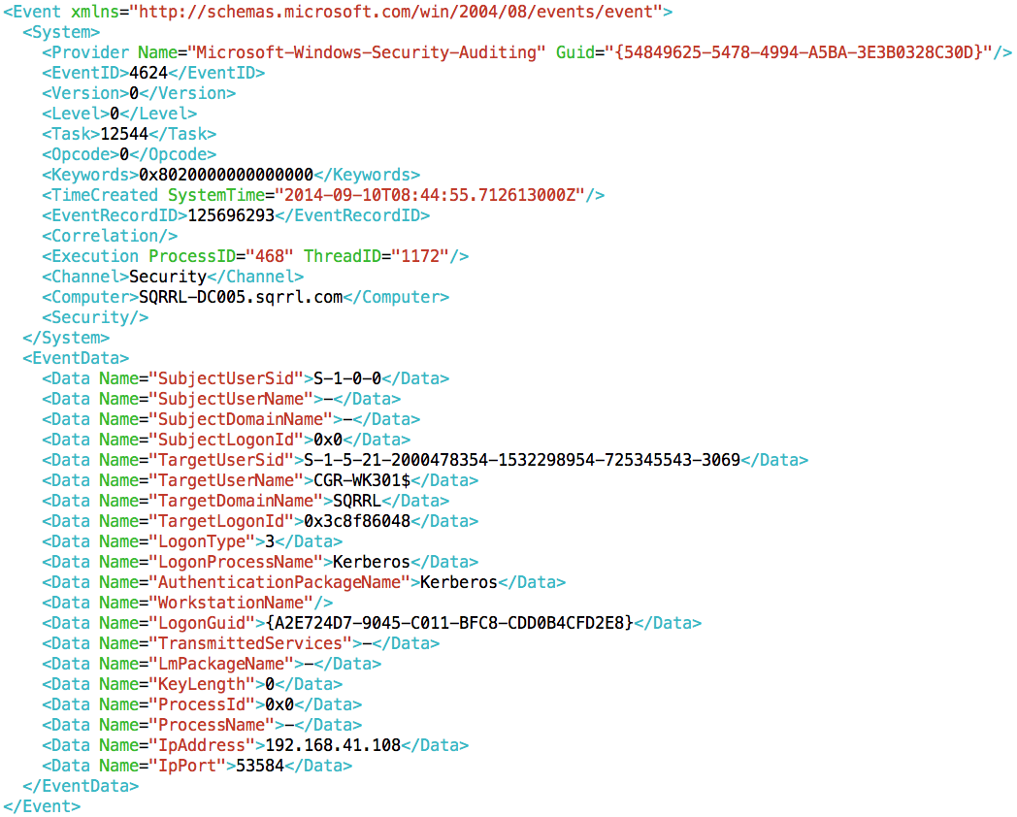
Data
LM evidence comes from:
Windows Events
Syslog
VPN
Endpoint sensors
Primary fields:
Source
Destination
User
Time
Extra Information:

Slide 11
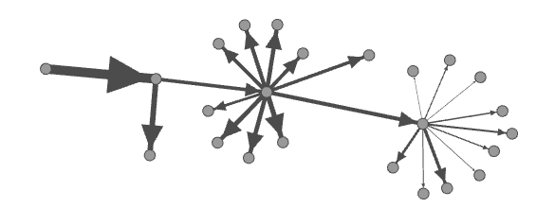
Abstraction Spectrum Trade-Off
Specialized
Generic
Target Specific Techniques
e.g. Pass The Hash detection
Very specific means low false positives
May miss new techniques
Search for General Graph Patterns
Hard to hide from
May pick up unrelated similar patterns

Slide 12
LM Graph Pattern Characteristics
(4) Fan-outs, including failed logins
(1) Expected Inter-login
Time Distribution
(5) Not too big,
Not too small
(3) Rarely-Seen Logins
(2) Overall Timeframe in expected range

Slide 13

Lateral Movement Strategy
Rank individual logins
Train: learn common user login patterns from the data
Predict: assign rank (logLikelihoodRatio) to every login. Rank high those that are unusual
Construct time-ordered connected sequences of logins
Predict: find top N sequences of logins with the highest combined rank

Slide 14
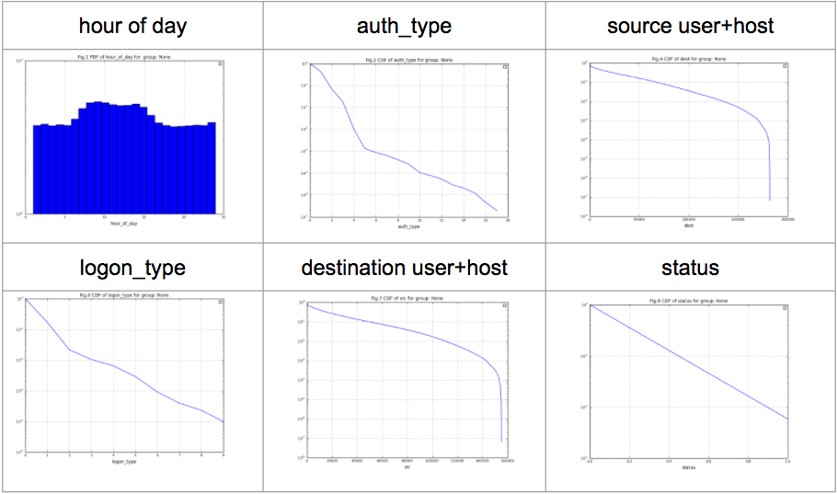
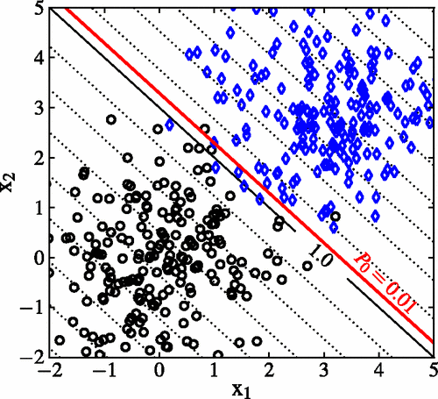
Generalized “Rarity” Classifier
Used to determine base risk for logins
Extensible feature vectors mix numerical, categorical, and text features
TDigests for numerical
Bag of words for text
Vectorized categorical statistics
Learns “normal” in-situ
Priors out-of-the-box
Every network is different
Scalable spark implementations

Slide 15



Multi-Hop Predict
192.168.1.101
192.168.1.104
192.168.1.78
192.168.1.83

Slide 16
Multi-Hop Predict: Combinatorics
General Problem: Subgraph Isomorphism
5 edges ➔ 2⁵ = 32 subgraphs
10 edges ➔ 2¹⁰ = 1024 subgraphs
20 edges ➔ 2²⁰ = 1,048,576 subgraphs
We run with billions of edges...
Solution: grow small subgraphs in parallel
Prune early and often
Aglomerative clustering
Message passing
192.168.1.101
192.168.1.104
192.168.1.78
192.168.1.83

Slide 17
Multi-Hop Predict: Message Passing

Slide 18
Multi-Hop Predict: Message Passing

Slide 19
Multi-Hop Predict: Message Passing

Slide 20

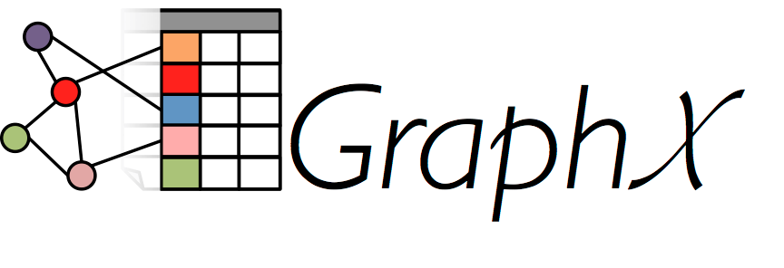
Scalable Analytic Implementation
Large scale, parallel implementation
Multiple Independent Variable Bayesian Classifier (MIVB)
Spark extension for graph processing
High performance message passing implementation
Used for agglomerative clustering / detection of LM structures

Slide 21
Processing Workflow
Spark / GraphX
Sqrrl CounterOps Model
Sqrrl Auth/Login Sources
Single-Hop Predict
Multi-Hop Predict
Evidence Tables
Classifier Training
Trained Classifier

Slide 22
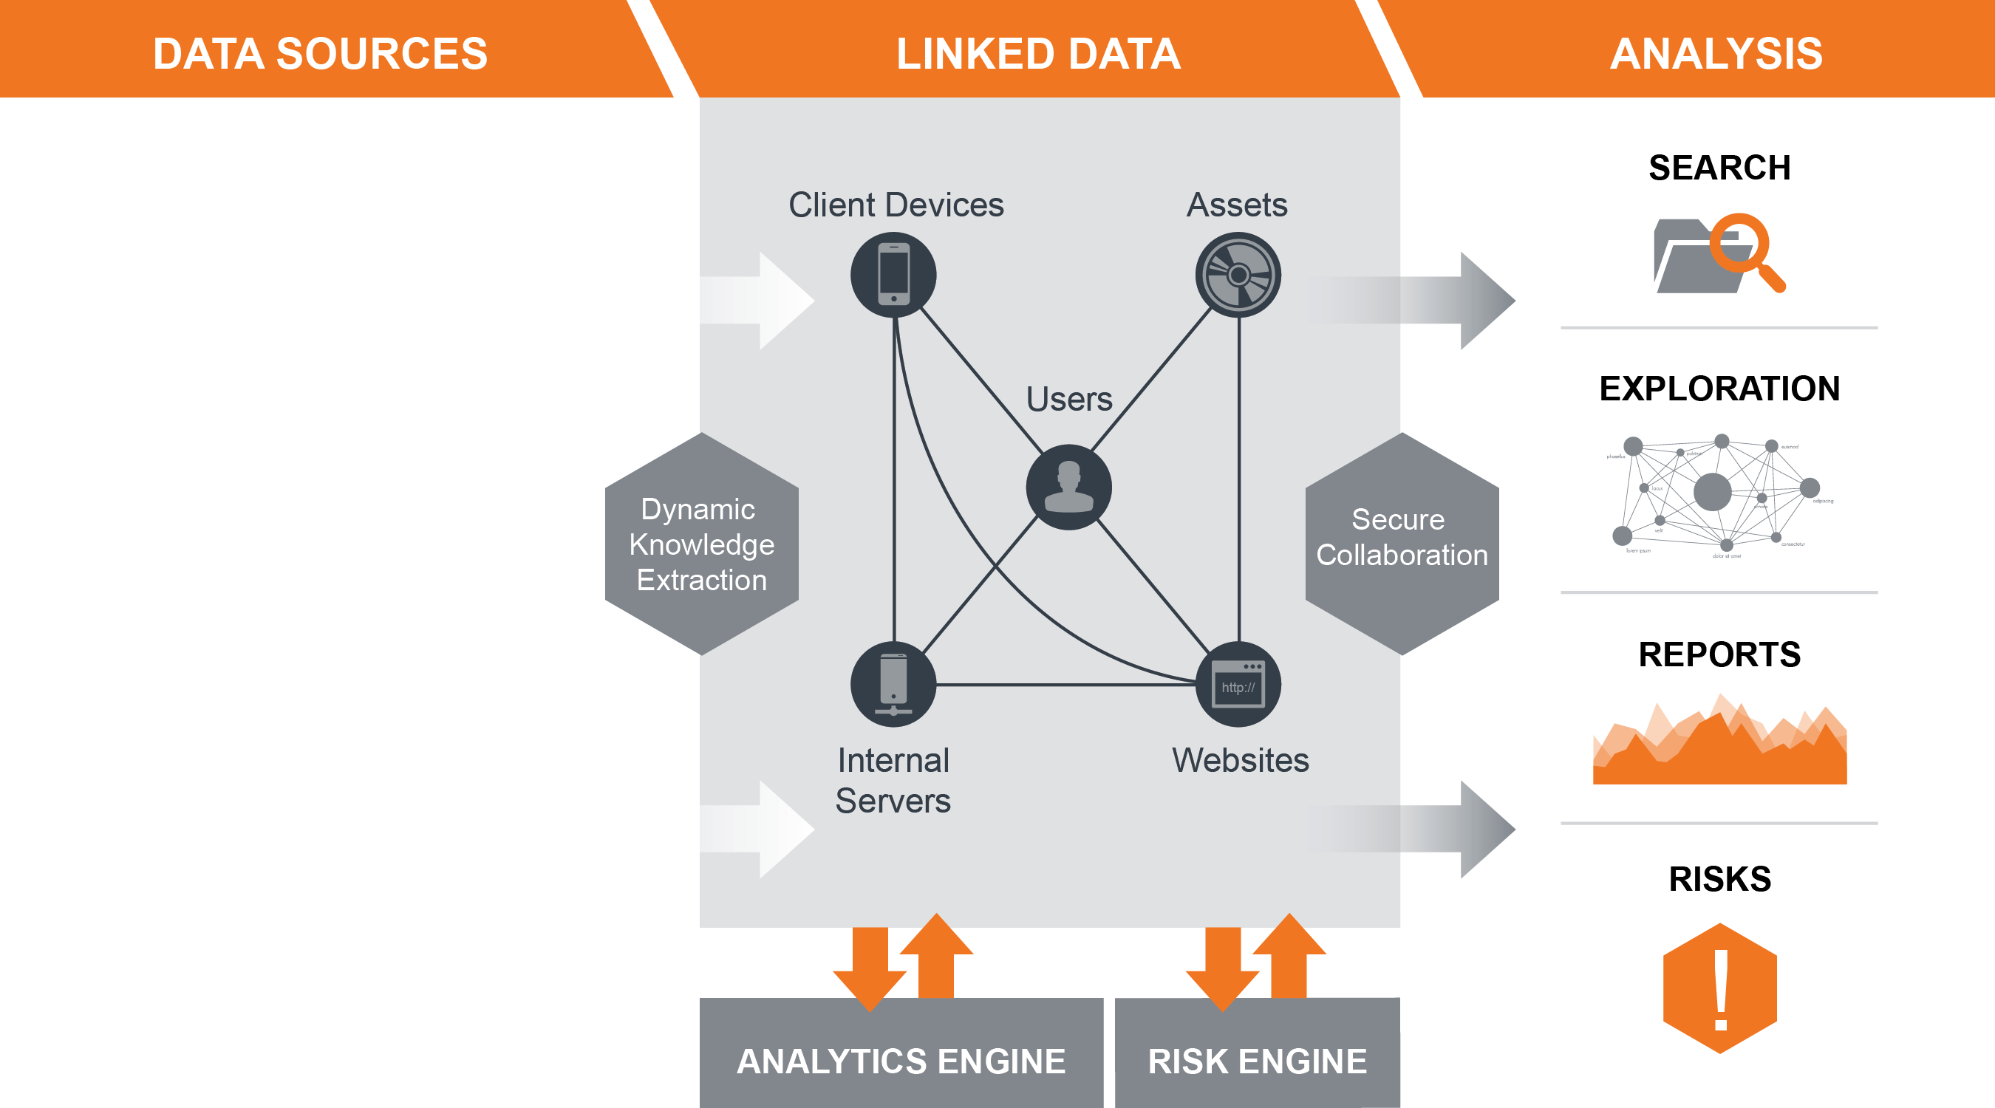











Organizing Security Data
SECURITY DATA
Analytics
Threat Intel
SIEM Alerts
NETWORK DATA
Proxy
Netflow
DNS
ENDPOINT/Identity DATA
HR
Authentication
Processes

Slide 23
False Positive Reduction
Rank:
Normalize:
Smooth out discontinuities in ranking function
Apply historical context to determine probability of seeing a given rank
Convert to risk score based on likelihood * impact
Threshold:
Analysts usually care about LMs over risk X
Base risk factor
Time risk factor
Size risk factor

Slide 24
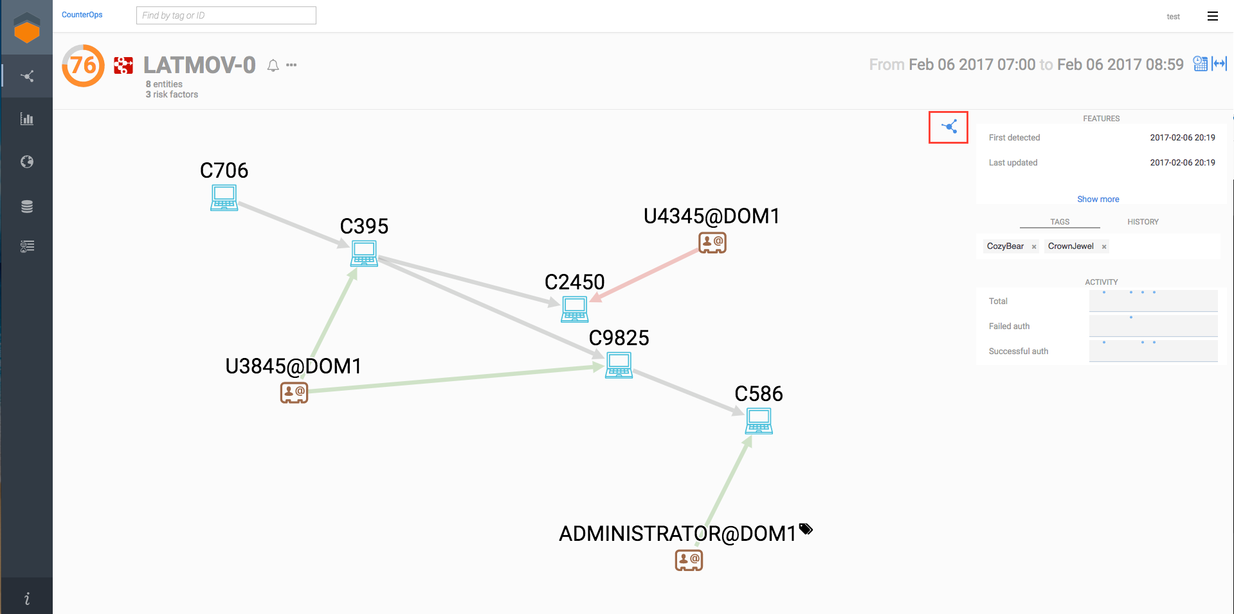
Building the LM Detector
Threat Hunters
Data Scientists
Computer Scientists
Security Analyst
High-Risk Classifier (Subgraphs)
Scalable Implementation
(Spark, GraphX)
TTP Alignment
Log-Likelihood Ranking
Deployable Workflow with In-Situ Training
Behavior and Structural Decomposition
Normality Classifier (MIVB)
Rank Statistics Normalization
Contextual Exploration and Visualization

Slide 25
Lateral Movement

Slide 26
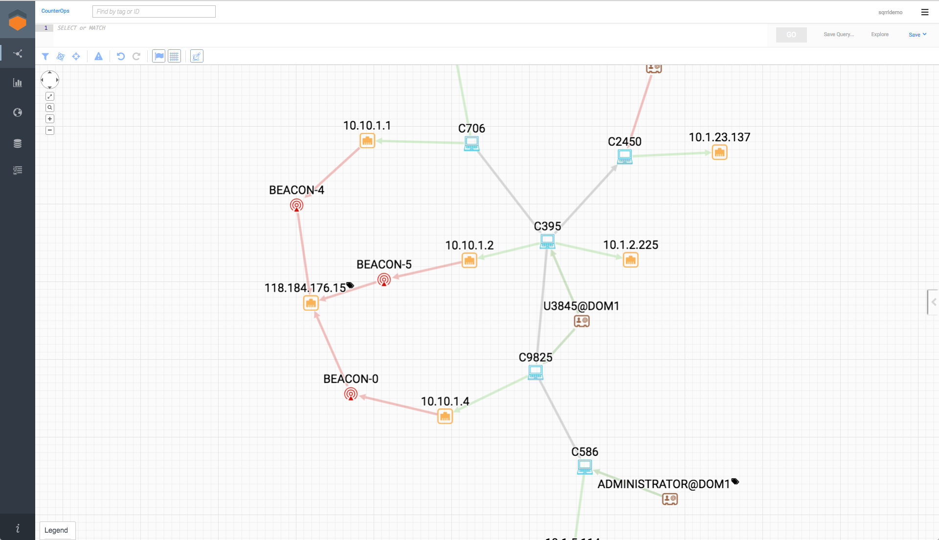
Lateral Movement

Slide 27
Thank you!
threathunting.org
For hunting eCourses, papers and other resources
&
threathunting.net
For a repository of hunting techniques

